Slide 1
IT Support Services RFP Information Session
September 30, 2016

Slide 2
RFP Timelines
RFP ISSUE DATE: MONDAY SEPTEMBER 12, 2016
SITE VISIT & INFORMATION SESSION: FRIDAY, SEPTEMBER 30, 2016
DEADLINE FOR PROPONENT ENQUIRIES: THURSDAY, OCTOBER 6, 2016 (No later than 3 pm local Toronto time)
DEADLINE FOR ISSUING ADDENDA’S &RESPONSES TO PROPONENT ENQUIRIES: TUESDAY, OCTOBER 11, 2016
PRPOSAL SUBMISSION DEADLINE: THURSDAY OCTOBER 20, 2016 (No later than 3 pm local Toronto time)
PROPONENT INTERVIEWS: WEEK OF NOVEMBER 7, 2016

Slide 3
Background
IT Evolution 2012-2016
Virtualization of all server workloads using Vmware and NetApp technologies across two data centers
Introduction of disciplined processes for privacy & security management and disaster recovery
Introduction of Records Management Program
Introduction of a Work-from-Home program
Replacement of the Oracle Fusion Middleware stack (WordPress/Igloo)
Introduction of Single Sign-On capabilities (EmpowerID)

Slide 4
Areas of Focus in 3rd Mandate
CPAC IT Team
Support the Partnership’s Digital Strategy and digital transformation projects
Successful Proponent
Managed Hosting
Service Desk Operations
IT Education & Training
Unified Communications
Change Management

Slide 5
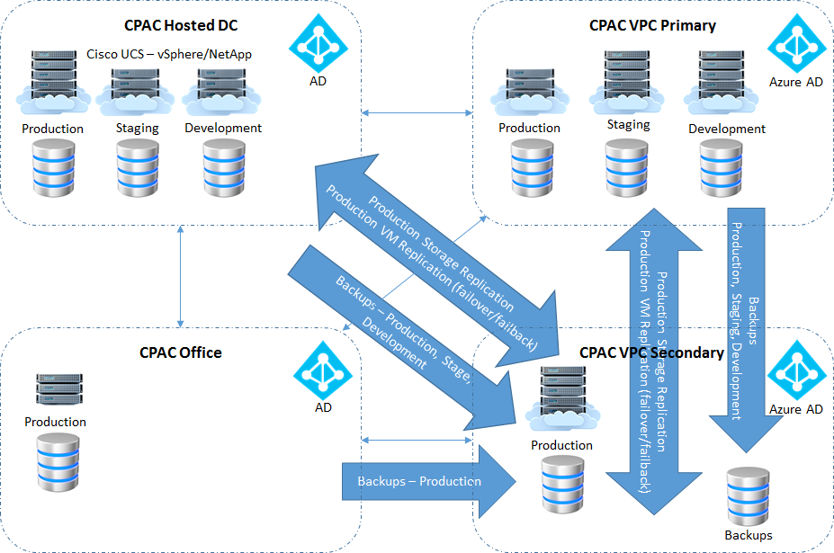
Managed Hosting
Transition to SaaS solutions
Consolidation and streamlining of operations
Transition to Azure Cloud Services for Disaster Recovery, extended computing and backup

Slide 6
Service Desk Operations
Service Desk Governance
Proactive instead of reactive, more robust auditing & reporting
Improve end user communications and use of IT related knowledge base
Service Desk Tool
Current tool, EasyVista, lacks required features
Remote Experience
Improve remote users experience and support

Slide 7
IT Education & Training
Boardroom lecture style staff training has not been an effective approach to retain IT knowledge
Education strategy to be more focused, practical use-case, hands-on walkthrough style training in 3rd mandate
Provide a more personalized custom approach to staff orientation training

Slide 8
Unified Communications
UCaaS solution for voice telephony, including single number reach
Conferencing — Audioconferencing, videoconferencing and Web conferencing
Messaging — Email with voice mail and unified messaging (UM)
Presence and instant messaging (IM)
Integration with Igloo & CRM

Slide 9
Change Management
High level of IT change in 2017 & 2018
New service desk tool & support staff
Transition to Office 365/Windows 10
New suite of Unified Communications tools

Slide 10
Next Steps
Proponent Enquiries due Thursday, October 6, 2016
Questions must be sent to: procurement@partnershipagainstcancer.ca
Responses to Questions due Tuesday October 11, 2016
Final Submission due Thursday October 20, 2016
Interviews to be held the week of November 7, 2016

Slide 11
Questions

